Slide 1


Airbnb Berlin
Data visualization
What Data tells us

Slide 2


You can find us here…
saran.jayathilak@ue-germany.de
bamideleemmanuel.adekanye@ue-germany.de
jimmi.george@ue-germany.de

Slide 3

AIRBNB in BERLIN
The aim of the project is to build interactive Dashboard on Airbnb accommodation in berlin with tableau.
A descriptive analysis of the dataset showing:
Map plots w.r.t zip code
Regions based on bed availability and user ratings.
Price trend over the years
What question are we trying to answer?

Slide 4
WHAT ARE WE GOING TO PRESENT?
Introduction to Tableau
Connecting Data
Visualization and Dashboards

Slide 5
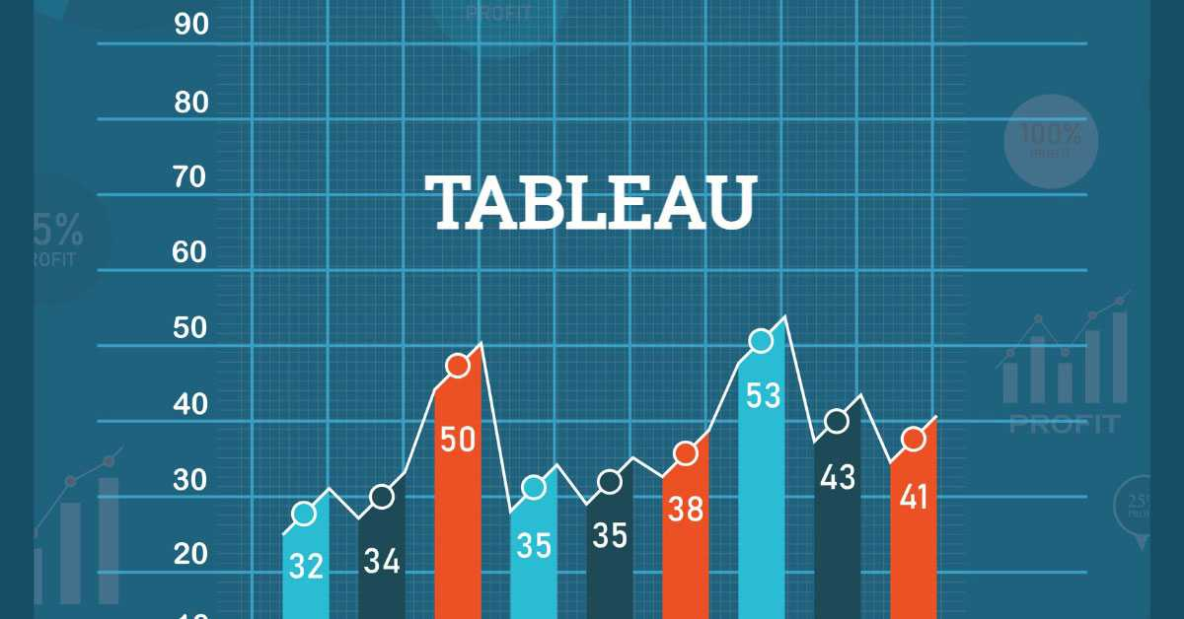
What is Tableau?
Tableau is a very powerful data visualization tool to visualize the data and get a clear opinion based on the data analysis.
Tableau also allows you to prepare, clean, and format data of all types and ranges and then create data visualizations to obtain actionable insights.
Tableau allows instantanious insights by transforming data into interactive visualization called Dashboards

Slide 6
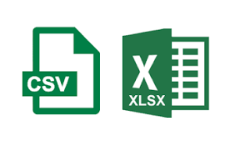

Data analysis tool and processes
Build data model
Develop metrics
Process data
Design visual
components
Raw Data
Dashboard

Slide 7
Process for creating dashboard on Tableau
Connect to data source
Connects and extract data stored in various data sources.
The data source page shows the sheets or tables available in the data pane
Examples of data sources are Excel, AWS, SQL database, Azure, Google cloud etc.
Build data views
Determine the suitable visuals such as chart, graph, map, plot etc.
Drag and drop fields from the data pane unto card, shelves in the worksheet
Enhance the views
Add depths into analysis with the use of filters, aggregation, etc.
Set field parameters such as measures, hierarchy, axis, color etc.
Create dashboard
Dashboards contain multiple worksheets that are linked.

Slide 8
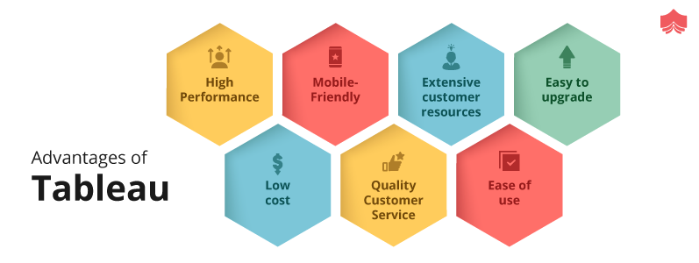

Slide 9


Data set collected from inside Airbnb and cleaned. 24423 Airbnb listings in Berlin and was compiled. Data source http://insideairbnb.com/get-the-data/
Data Collection and Cleaning
Notes:
.

Slide 10

Connecting Data
Tableau supports connecting to a wide variety of data, stored in a variety of places.
For example, your data might be stored on your computer in a spreadsheet or a text file, or in a big data or to a cloud database source, such as Google Analytics, Amazon Redshift, or Salesforce.

Slide 11
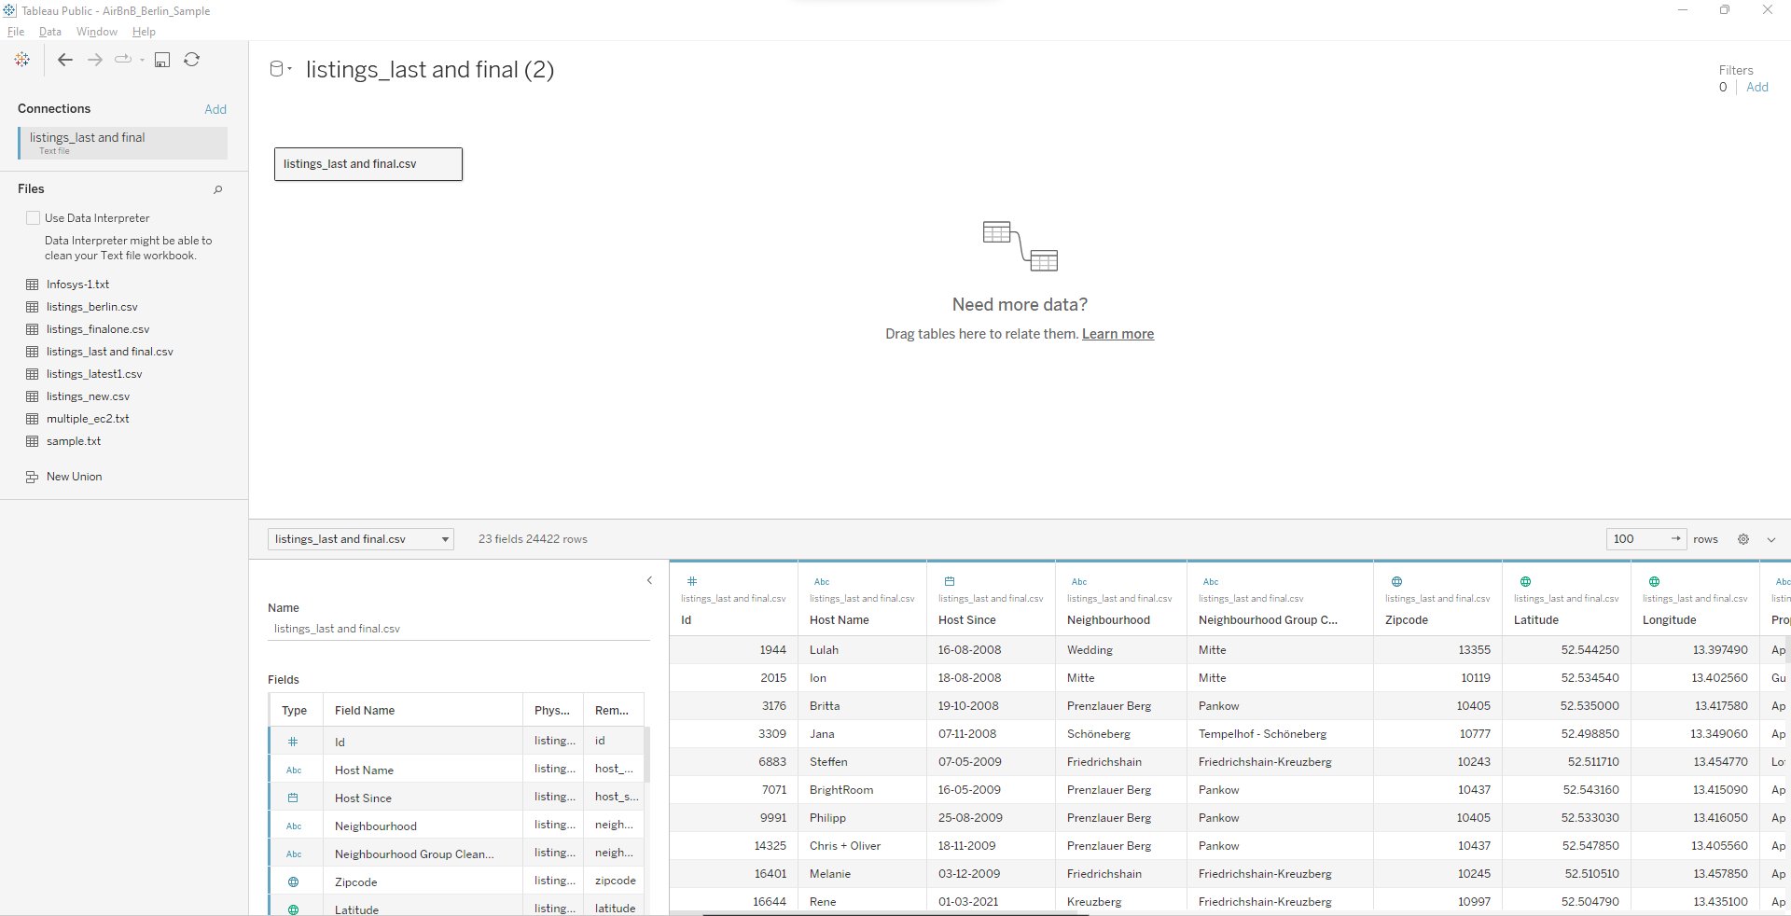
Tableau Desktop
Used for analytics and dashboard development
Used to author and manage data connections
Installed on the local machine
Can publish directly to Tableau Server

Slide 12
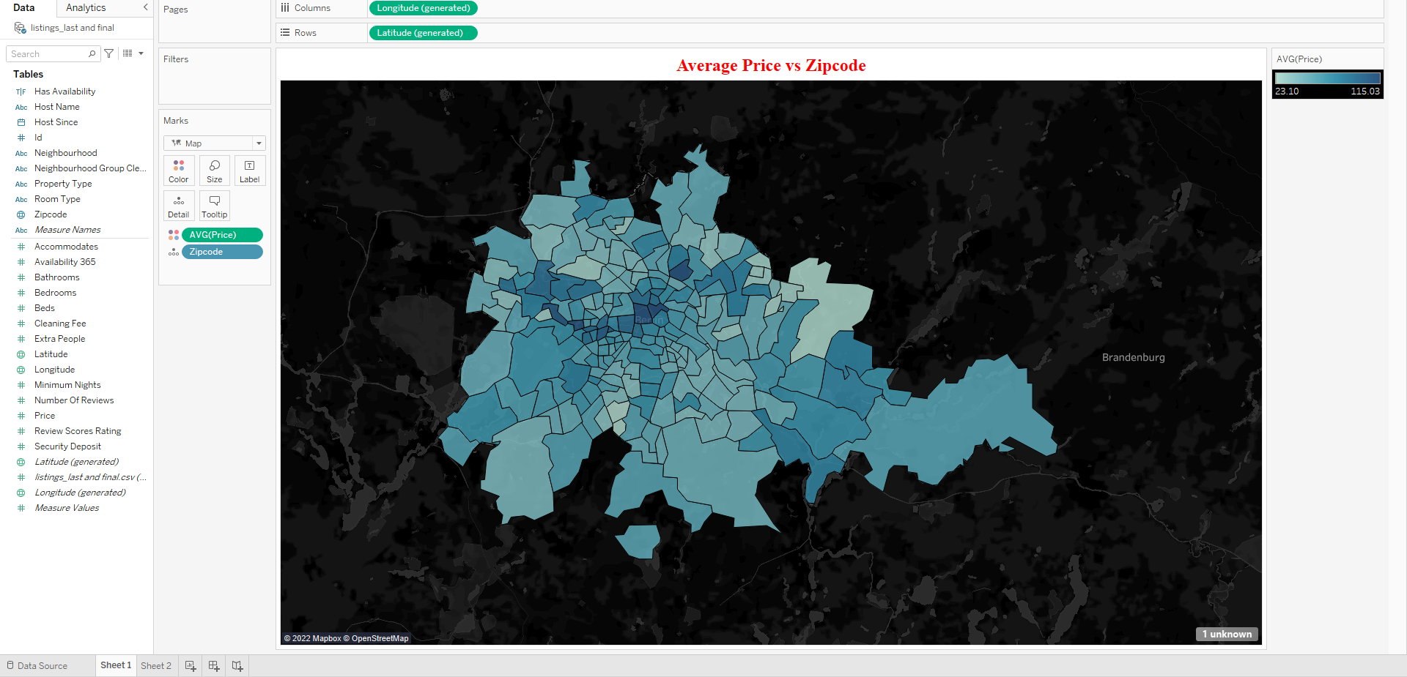
Average Price with respect to Zip Code

Slide 13
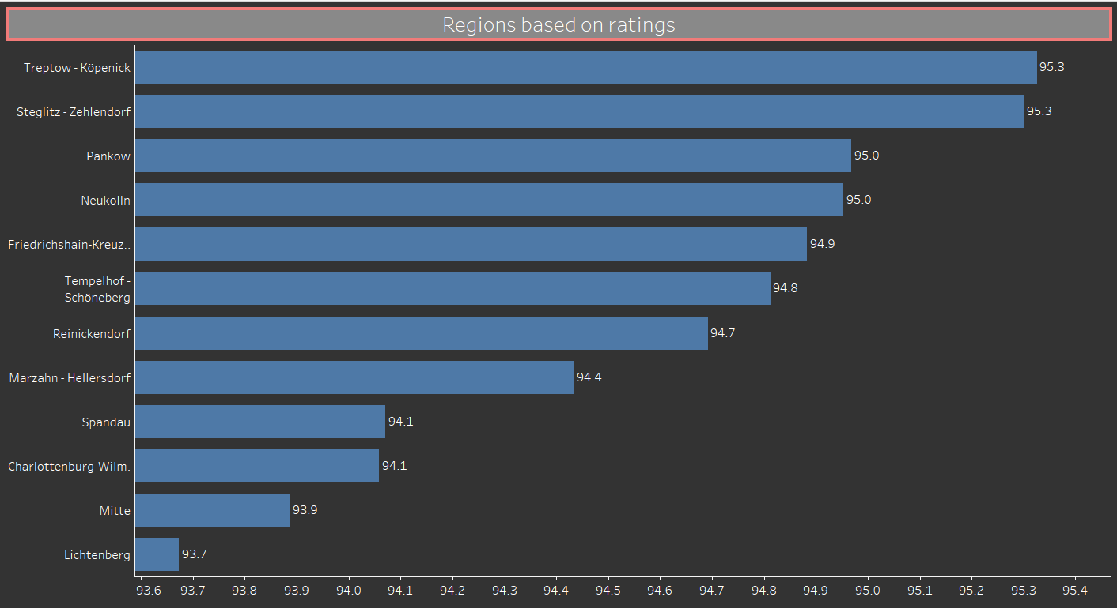
Regions with respect to Rating

Slide 14
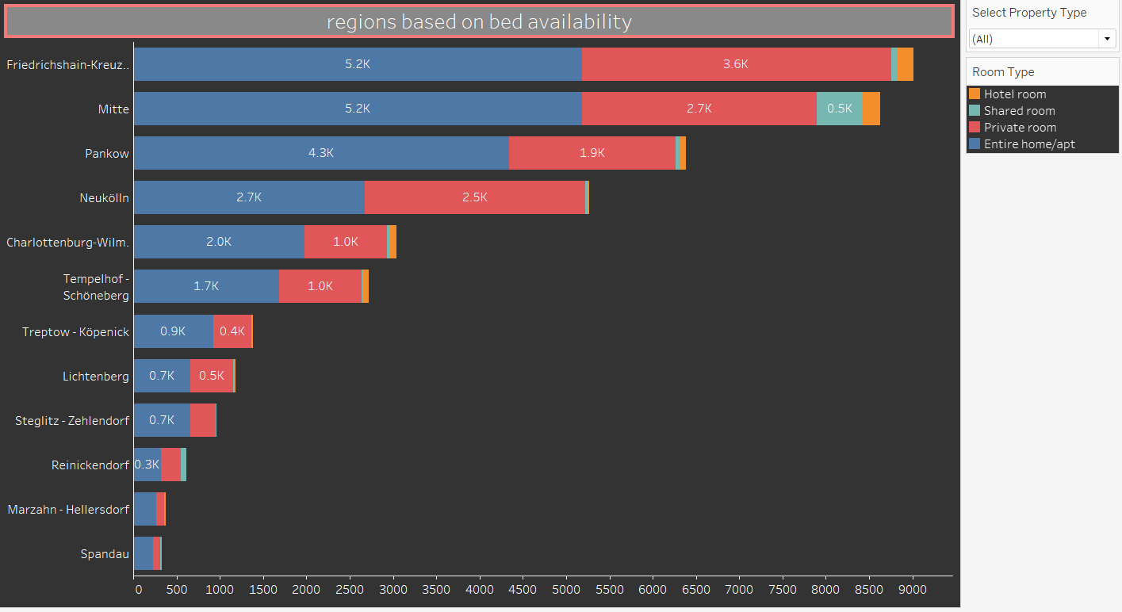
Regions with respect to Bed availability

Slide 15
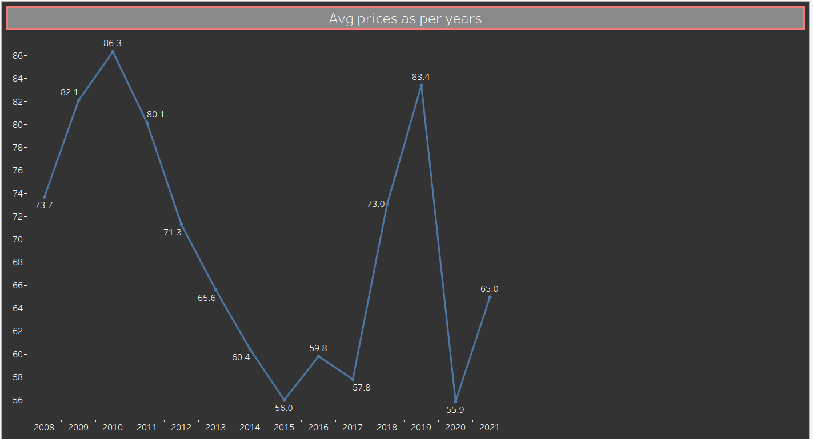
Average price with respect to Years

Slide 16

Dashboard Flow Hands on

Slide 17
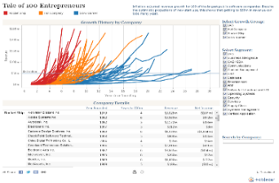
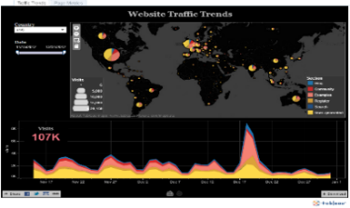
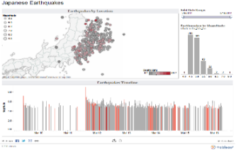
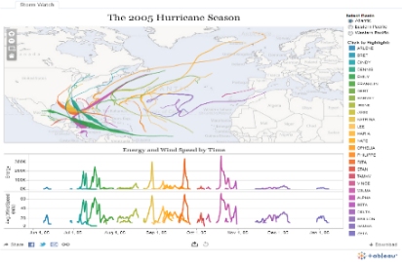
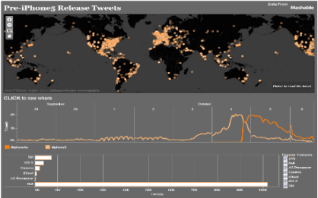
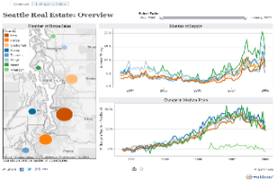
What is a dashboard?
“A dashboard is a visual display of data used to monitor conditions and/or facilitate understanding”
Big Book of Dashboards (2017)
Link for Dashboard
https://public.tableau.com/app/profile/jimmi.george/viz/airbnbdashboard_16547292842350/airbnbdashboard

Slide 18
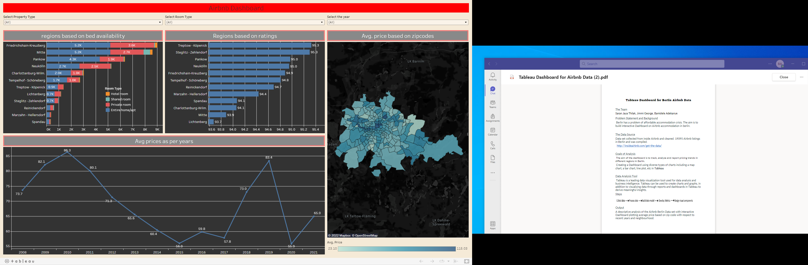
Output Dashboard
Interactive filters are added to the dashboard to relate to multiple graphs.

Slide 19
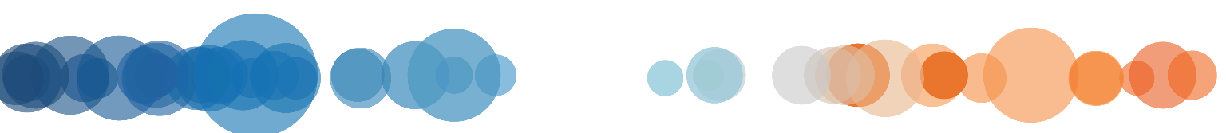
THANK YOU!
Notes:
Full Page Image w Color Bar

